Slide 1

BIG DATA PROCESSING AND ANALYTICS
UNIT 3

Slide 2
CONTENT
Map Reduce programming model for distributed data processing
Introduction to Apache Spark:
RDDs
Data Frames
Spark SQL,
Machine learning algorithms for big data analytics:
Classification
Regression
Clustering
Real-time analytics and stream processing with Apache Flink.

Slide 3
MapReduce
MapReduce
model for performing Big Data analytics.
It is primarily designed for distributed platforms, like clusters.
There are three main implementations:
Google's proprietary version.
Hadoop (open-source)
Spark (open-source)
Other platforms stem from these basic frameworks.
Core Idea
The core idea revolves around two main input functions:
Map function: Processes data in parallel using available resources.
Reduce function: Aggregates the processed data.
Distributed storage systems
such as HDFS (Hadoop Distributed File System) and Google File System (GFS) work with MapReduce to handle input, intermediate, and output data.

Slide 4
MapReduce
MapReduce Workflow : involves three steps
Mapping Step: Programmer implements the Map function.
The input dataset is partitioned and stored in a distributed file system (DFS).
Each Map task processes a partition and generates intermediate data, which is stored locally on the worker nodes.
Shuffling Step:
The intermediate data is distributed across the computational resources to prepare for the Reduce step.
This step is often a communication bottleneck due to its all-to-all data distribution.
Reduce Step:
The Reduce function is executed to generate the final output from the intermediate data.
Multistage MapReduce Jobs
Multistage MapReduce jobs are common, where the output of one MapReduce job serves as the intermediate data for the next job.
An example is Yahoo! WebMap, where a chain of MapReduce jobs processes web data.

Slide 5
Shortcoming of MapReduce
Rigid Structure Enforcing Map and Reduce Phases:
MapReduce enforces a strict data processing flow that must fit into the Map and Reduce phases. This restricts flexibility, as other useful data processing operations, such as joins, filters, flatMap, groupByKey, unions, and intersections, are either missing or not natively supported.
Lack of Comprehensive Workflows:
Beyond simple Map and Reduce tasks, more complex workflows like data joins, filtering, and transformations are not well-supported. These operations often require custom coding or additional frameworks to handle efficiently.
Acyclic Data Flow:
MapReduce is designed around an "acyclic data flow," where data flows from disk to disk, with intermediate results written to disk (HDFS). This design results in slow performance since each phase must read from and write to disk.
Stateless Nature of MapReduce:
The architecture treats each node as a stateless machine. After each Map or Reduce phase, the system must save the results to disk, which can lead to significant inefficiencies, especially in tasks requiring frequent iterations, such as machine learning algorithms.

Slide 6
Shortcoming of MapReduce
Inefficient for Iterative Tasks:
Due to constant disk I/O between phases, MapReduce performs poorly for iterative tasks, such as those required in machine learning, where data needs to be processed repeatedly.
Java-Centric Support:
The original MapReduce framework was primarily designed for Java. While other languages can be used through additional frameworks, the native support is Java-centric, and additional effort is required to support other languages.
Designed for Batch Processing:
MapReduce was built for batch processing, where large amounts of data are processed in batches. It is not optimized for real-time or interactive data processing.
Lack of Support for Real-Time Processing:
MapReduce does not natively support interactive data analysis or streaming data processing. Additional frameworks like Apache Spark or Apache Flink are required for such use cases.

Slide 7

Apache Spark

Slide 8
One Solution is Apache Spark
A Modern General Framework:
This framework addresses many of the limitations inherent in MapReduce, offering a more versatile and powerful solution for distributed data processing.
Integration with Hadoop Ecosystem:
It seamlessly integrates with the Hadoop ecosystem, utilizing existing components such as HDFS (Hadoop Distributed File System), YARN (Yet Another Resource Negotiator), HBase, S3 (Amazon’s Simple Storage Service), and more. This ensures compatibility with widely used data storage and management systems.
Extensive Workflow Support:
Unlike MapReduce, this framework supports a wide variety of workflows, such as joins, filters, flatMap, distinct, groupByKey, reduceByKey, sortByKey, collect, count, first, and more. It offers around 30 efficient distributed operations, making it much more flexible and suitable for complex data processing tasks.
In-Memory Caching:
One of its standout features is the ability to cache data in memory, which significantly speeds up iterative operations. This is particularly beneficial for tasks like graph processing, machine learning algorithms, and any other iterative computations.

Slide 9
One Solution is Apache Spark
.Multi-Language Support:
The framework natively supports multiple popular programming languages, including Scala, Java, Python, and R, making it accessible to a wide range of developers.
Interactive Shells for Data Analysis:
It provides interactive shells for languages like Scala and Python, enabling exploratory data analysis and real-time interaction with data, which is a significant improvement over the batch processing nature of MapReduce.
User-Friendly Spark API:
The Spark API is designed to be extremely simple and intuitive to use, allowing developers to quickly implement data processing tasks without needing extensive boilerplate code or complicated configurations.
Development and Origin:
Originally developed at UC Berkeley’s AMPLab, it is now maintained and further developed by Databricks, a company founded by the creators of this framework. Databricks continues to push innovation in the big data processing field.

Slide 10
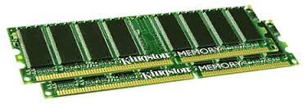
Spark Uses Memory instead of Disk
Hadoop: Use Disk for Data Sharing
HDFS
read
HDFS
Write
HDFS
read
HDFS
Write
Iteration1
Iteration2
HDFS read
Iteration1
Iteration2
Spark: In-Memory Data Sharing

Slide 11
MapReduce vs Apache spark
Feature | MapReduce | Apache Spark
Developed By | Google (original implementation) | Apache Software Foundation
Processing Model | Disk-based (writes intermediate data to disk) | In-memory (stores intermediate data in memory)
Speed | Slower due to multiple read/write operations to disk | Faster due to in-memory processing
Ease of Use | Requires writing multiple MapReduce jobs for complex tasks | Higher-level APIs (e.g., DataFrames, Datasets) simplify code
API Support | Only supports Map and Reduce functions | Supports rich APIs: Map, Reduce, Join, Filter, etc.
Data Processing Type | Batch processing | Both batch and real-time (stream) processing
Latency | High latency due to disk I/O | Low latency because of in-memory operations
Fault Tolerance | High (uses HDFS for replication) | High (utilizes lineage graphs to recover lost data)
Use of Iterations | Poor handling of iterative algorithms (needs separate jobs for each iteration) | Optimized for iterative algorithms, processes data in memory
Memory Requirement | Lower, more disk-based | Higher, needs more memory for in-memory processing

Slide 12
MapReduce vs Apache spark
Feature | MapReduce | Apache Spark
Fault Recovery | Recovery by restarting failed tasks and using HDFS replicas | Recovery using lineage and in-memory data
Supported Languages | Java, Python, C++ | Java, Scala, Python, R, SQL
Machine Learning Libraries | Limited (Mahout) | Comprehensive support (MLlib, GraphX)
Use Case | Suitable for simple, large-scale batch processing | Suitable for iterative, real-time, and machine learning tasks
Resource Management | Uses Hadoop YARN | Can use Hadoop YARN, Mesos, or standalone cluster manager
Complexity | More complex for multi-step workflows (e.g., chaining MapReduce jobs) | Less complex for multi-step operations (integrates multiple steps in a single job)
Performance | Slower for iterative tasks or small datasets | Much faster due to DAG (Directed Acyclic Graph) execution

Slide 13
Spark vs MapReduce
MapReduce requires files to be stored in HDFS, Spark does not!
Spark also can perform operations up to 100x faster than MapReduce
So how does it achieve this speed?
MapReduce writes most data to disk after each map and reduce operation
Spark keeps most of the data in memory after each transformation
Spark can spill over to disk if the memory is filled

Slide 14
Spark
You can think of Spark as a flexible alternative to MapReduce
Spark can use data stored in a variety of formats
Cassandra
AWS S3
HDFS
And more

Slide 15
Apache Spark
Scala, Java, Python, R, SQL
Apache Spark supports data analysis, machine learning, graphs, streaming data, etc. It can read/write from a range of data types and allows development in multiple languages.
DataFrames
ML Pipelines
Spark SQL
Spark Streaming
MLlib
GraphX
Spark Core
Data Sources
Hadoop HDFS, HBase, Hive, Apache S3, Streaming, JSON, MySQL, and HPC-style (GlusterFS, Lustre)

Slide 16
Spark RDDs
At the core of Spark is the idea of a Resilient Distributed Dataset (RDD)
Resilient Distributed Dataset (RDD) has 4 main features:
Distributed Collection of Data
Fault-tolerant
Parallel operation - partioned
Ability to use many data sources

Slide 17
SPARK RDD
Spark Core:
The foundational engine responsible for scheduling, memory management, fault recovery, and distributed processing.
Spark SQL:
Used for structured data processing, Spark SQL allows users to run SQL queries, read data from various sources, and join data from different formats.
Spark Streaming:
Provides scalable and fault-tolerant stream processing of live data streams.
MLlib:
A machine learning library for scalable and distributed machine learning tasks.
GraphX:
For processing and analysing graph data.

Slide 18


Spark RDDs

Slide 19
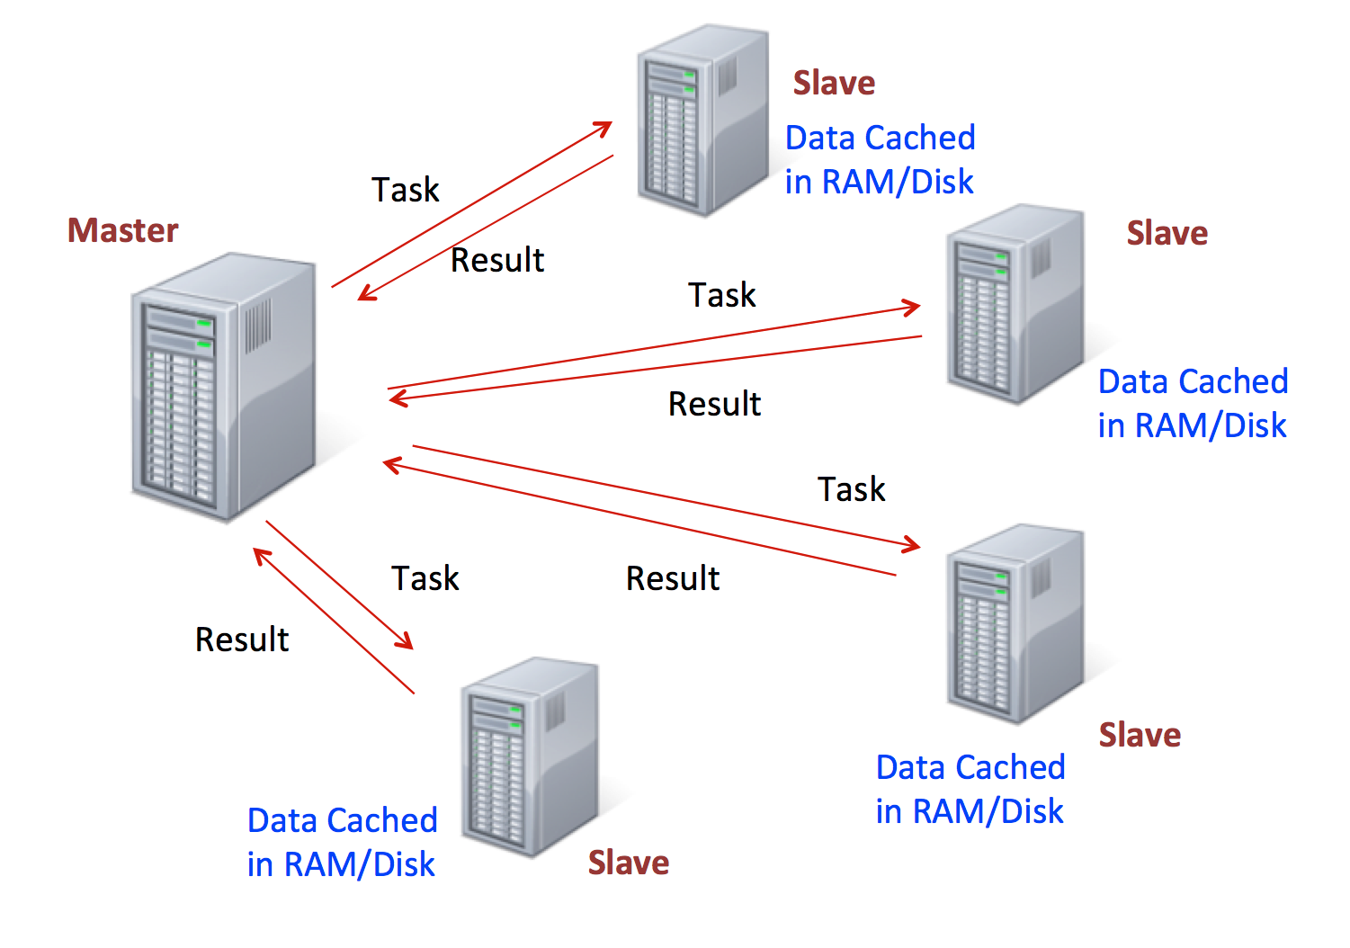
Spark RDDs

Slide 20
Spark RDDs
RDDs are immutable, lazily evaluated, and cacheable
There are two types of Spark operations:
Transformations
Actions
Transformations are basically a recipe to follow.
Actions actually perform what the recipe says to do and returns something back.

Slide 21
This behaviour carries over to the syntax when coding.
A lot of times you will write a method call, but won’t see anything as a result until you call the action.
This makes sense because with a large dataset, you don’t want to calculate all the transformations until you are sure you want to perform them!
Spark RDDs

Slide 22
Spark RDDs
When discussing Spark syntax you will see RDD versus DataFrame syntax show up.
With the release of Spark 2.0, Spark is moving towards a DataFrame based syntax, but keep in mind that the way files are being distributed can still be thought of as RDDs, it is just the typed out syntax that is changing

Slide 23
Spark DataFrames
Spark DataFrames are also now the standard way of using Spark’s Machine Learning Capabilities.
Spark DataFrame documentation is still pretty new and can be sparse.

Slide 24

Spark DataFrames

Slide 25
Python and Spark
Spark DataFrames hold data in a column and row format.
Each column represents some feature or variable.
Each row represents an individual data point.

Slide 26
Python and Spark
Spark began with something known as the “RDD” syntax which was a little ugly and tricky to learn.
Now Spark 2.0 and higher has shifted towards a DataFrame syntax which is much cleaner and easier to work with!
Spark DataFrames can input and output data from a wide variety of sources.
We can then use these DataFrames to apply various transformations on the data.

Slide 27
Key Features of Spark DataFrames
Schema Information:
DataFrames have schema information, meaning each column has a name and a type (string, integer, etc.).
Optimized Execution:
They provide an abstraction that allows Spark's Catalyst Optimizer to optimize execution plans, resulting in more efficient queries.
Support for a Variety of Data Sources:
DataFrames can be created from structured data files (e.g., CSV, JSON), tables in Hive, or external databases.
Integration with SQL:
You can run SQL queries directly on DataFrames, which can integrate well with both structured and semi-structured data.
Lazy Execution:
Like RDDs, DataFrames are lazily evaluated, meaning that transformations are not executed until an action is triggered.

Slide 28
Spark DataFrames Implementation Example in Python (PySpark)
from pyspark.sql import SparkSession
# Create a Spark session
spark = SparkSession.builder.appName("DataFrameExample").getOrCreate()
#The SparkSession object is the entry point to programming with DataFrames.
# Create a sample DataFrame from a list of tuples
data = [("Alice", 29), ("Bob", 31), ("Catherine", 25)]
columns = ["Name", "Age"]
df = spark.createDataFrame(data, columns)
# Show the DataFrame
df.show()
OUTPUT
+----------+---+
| Name|Age|
+----------+---+
| Alice| 29|
| Bob| 31|
| Catherine| 25|
+----------+---+

Slide 29
Loading Data from a CSV File
# Load data from a CSV file into a DataFrame
df = spark.read.csv("path/to/file.csv", header=True, inferSchema=True)
# Show the first 5 rows of the DataFrame
df.show(5)
#The inferSchema=True parameter allows Spark to automatically detect the schema of the file, and header=True treats the first row as a header.

Slide 30
Basic DataFrame Operations
Filtering: Select rows based on conditions.
df.filter(df.Age > 30).show()
Selecting Columns: You can select specific columns using the select() method.
df.select("Name", "Age").show()
Grouping and Aggregating Data: You can group data by columns and perform aggregations like sum, average, etc.
df.groupBy("Age").count().show()
SQL Queries on DataFrames:
# Register the DataFrame as a SQL temporary view
df.createOrReplaceTempView("people")
# Query using SQL
spark.sql("SELECT Name, Age FROM people WHERE Age > 30").show()
Writing DataFrame to Disk
#Save DataFrame to CSV:
df.write.csv("output/path", header=True)
#Save DataFrame as Parquet:
df.write.parquet("output/path")

Slide 31
Spark SQL
Spark module that allows users to run SQL queries on large datasets stored in distributed systems.
01
It supports querying structured and semi-structured data and integrates well with Spark's DataFrame API.
02
Spark SQL enables querying data via SQL as well as via the DataFrame API
03
Providing flexibility for working with data in a relational manner, even on distributed datasets.
04

Slide 32
Key Features of Spark SQL
Unified Data Access:
Spark SQL allows you to work with structured data from different sources like JSON, Parquet, Hive tables, JDBC, etc.
Integration with SQL:
You can use SQL queries seamlessly alongside Spark's native APIs.
Catalyst Optimizer:
Spark SQL uses an advanced query optimizer called the Catalyst Optimizer, which analyzes query plans and optimizes them for performance.
Compatibility with Hive:
Spark SQL can query existing Hive tables and access data stored in Hive’s metadata store.
Supports UDFs (User-Defined Functions):
You can define your custom functions and use them in SQL queries.

Slide 33
Spark SQL Example
from pyspark.sql import SparkSession
# Create a Spark session
spark = SparkSession.builder.appName("SparkSQLExample").getOrCreate()
# Load data from a CSV file into a DataFrame
df = spark.read.csv("path/to/people.csv", header=True, inferSchema=True)
# Show the DataFrame
df.show()
# Register DataFrame as a SQL temporary view
df.createOrReplaceTempView("people")
# Run SQL query
sqlDF = spark.sql("SELECT Name, Age FROM people WHERE Age > 30")
sqlDF.show()

Slide 34
# Using SQL functions to aggregate data
resultDF = spark.sql("SELECT AVG(Age) as Average_Age FROM people")
resultDF.show()
# Write DataFrame to Parquet format
df.write.parquet("people.parquet")
# Read the Parquet file into a DataFrame
parquetDF = spark.read.parquet("people.parquet")
# Create a SQL temporary view from the Parquet data
parquetDF.createOrReplaceTempView("parquet_people")
# Query the Parquet data using SQL
spark.sql("SELECT * FROM parquet_people WHERE Age > 30").show()

Slide 35
Using Hive with Spark SQL
# Enable Hive support
spark = SparkSession.builder.appName("SparkSQLHiveExample").enableHiveSupport().getOrCreate()
# Create a Hive table from a DataFrame
df.write.saveAsTable("people_hive_table")
# Query the Hive table
spark.sql("SELECT * FROM people_hive_table WHERE Age > 30").show()

Slide 36
User-Defined Functions (UDFs)
from pyspark.sql.functions import udf
from pyspark.sql.types import StringType
# Define a UDF to transform a column
def age_category(age):
return "Senior" if age > 50 else "Adult"
# Register the UDF
spark.udf.register("ageCategory", age_category, StringType())
# Use the UDF in an SQL query
spark.sql("SELECT Name, Age, ageCategory(Age) as Category FROM people").show()

Slide 37
Regression ML
Regression is a statistical technique used in predictive modeling to determine the relationship between one dependent variable (target) and one or more independent variables (predictors).
It’s widely used in forecasting and predicting numerical values.
Types of Regression:
Linear Regression:
Models the relationship between the dependent and independent variable(s) by fitting a straight line to the data.
Multiple Linear Regression:
Extends linear regression by using multiple predictors to predict the target.
Polynomial Regression:
Models non-linear relationships by transforming predictors into higher-degree polynomials.
Logistic Regression:
Used for binary classification (though technically not a regression model, it’s often included under the term due to its similar approach).

Slide 38
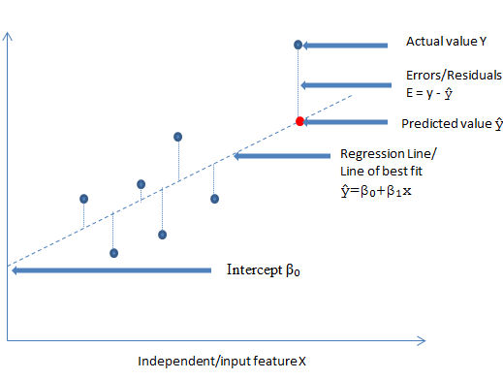
Linear regression
a visual representation of a simple linear regression model

Slide 39
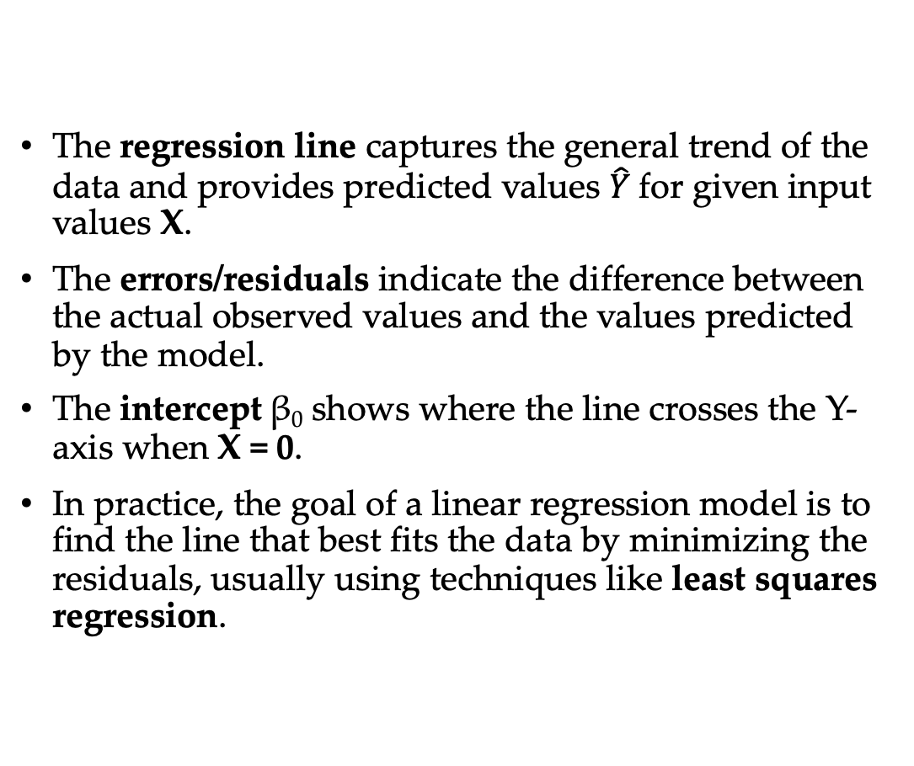
Linear Regression
The regression line captures the general trend of the data and provides predicted values $\hat{Y}$for given input values X.
The errors/residuals indicate the difference between the actual observed values and the values predicted by the model.
The intercept β₀ shows where the line crosses the Y-axis when X = 0.
In practice, the goal of a linear regression model is to find the line that best fits the data by minimizing the residuals, usually using techniques like least squares regression.

Slide 40
Linear Regression
Regression Line (Line of Best Fit):
The dashed line is the regression line which represents the relationship between the independent (input) variable X and the dependent (target) variable Y.
The equation of the line is:
$\hat{Y}$=β₀+β₁X where:
$\hat{Y}$ is the predicted value of Y,
β_{o} is the intercept, representing the point where the line crosses the Y-axis,
β₁​ is the slope, representing the rate of change of Y with respect to X.
Independent/Input Feature (X):
The X-axis represents the independent variable or feature, denoted as X. It is the input feature we use to predict the dependent variable.
Dependent/Target Feature (Y):
The Y-axis represents the dependent variable or the target we are trying to predict, denoted as Y. It depends on the input feature X.

Slide 41
Linear Regression
Predicted Value $\hat{Y}$:
The red dot on the regression line represents the predicted value $\hat{Y}$for a given X. This is the value predicted by the regression model for a particular input value of X.
Actual Value (Y):
The blue dots above and below the regression line represent the actual values of Y for the corresponding X values. These are the true target values in the dataset.
Errors/Residuals (E):
The vertical lines between the actual data points (blue dots) and the regression line represent the residuals or errors, denoted as E.
Residual (Error) is the difference between the actual value Y and the predicted value
$\hat{Y}$: E=Y− $\hat{Y}$E = Y - $\hat{Y}$
These errors indicate how far off the predictions are from the actual data points. In linear regression, the goal is to minimize the sum of these residuals.
Intercept (β₀):
The intercept, denoted as β_{o}, is where the regression line intersects the Y-axis. This represents the predicted value of Y when X is zero.

Slide 42
Logistic Regression
Not all labels are continuous, sometimes you need to predict categories, this is known as classification.
Logistic Regression is one of the basic ways to perform classification (don’t be confused by the word “regression”)

Slide 43
Logistic Regression
We want to learn about Logistic Regression as a method for Classification.
Some examples of classification problems:
Spam versus “Ham” emails
Loan Default (yes/no)
Disease Diagnosis
Above were all examples of Binary Classification
Math &
Statistics
Machine Learning
DS
Software
Research
Domain
Knowledge

Slide 44
Background
So far we’ve only seen regression problems where we try to predict a continuous value.
Although the name may be confusing at first, logistic regression allows us to solve classification problems, where we are trying to predict discrete categories.
The convention for binary classification is to have two classes 0 and 1.
Math &
Statistics
Machine Learning
DS
Software
Research
Domain
Knowledge

Slide 45
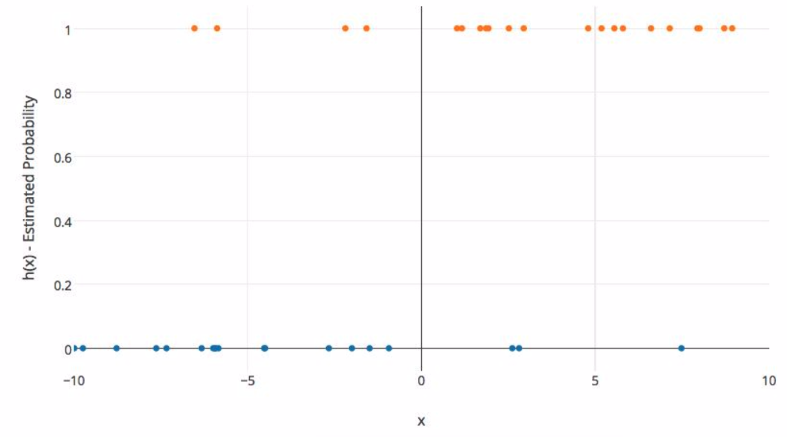
Background
Imagine we plotted out some categorical data against one feature.
Math &
Statistics
Machine Learning
DS
Software
Research
Domain
Knowledge

Slide 46
Background
The X axis represents a feature value and the Y axis represents the probability of belonging to class 1.
Math &
Statistics
Machine Learning
DS
Software
Research
Domain
Knowledge

Slide 47
Background
We can’t use a normal linear regression model on binary groups. It won’t lead to a good fit:
Math &
Statistics
Machine Learning
DS
Software
Research
Domain
Knowledge

Slide 48
Background
We need a function that will fit binary categorical data!
Math &
Statistics
Machine Learning
DS
Software
Research
Domain
Knowledge

Slide 49
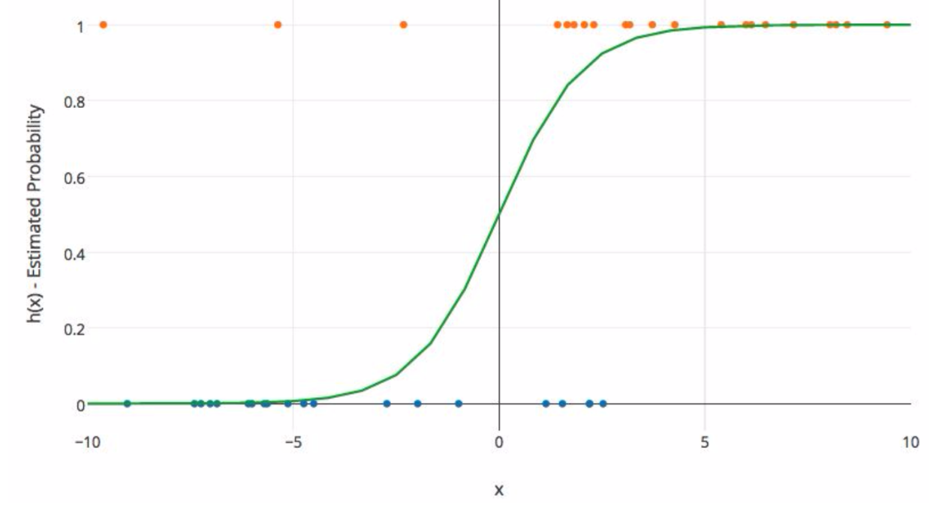
Background
It would be great if we could find a function with this sort of behavior:
Math &
Statistics
Machine Learning
DS
Software
Research
Domain
Knowledge

Slide 50
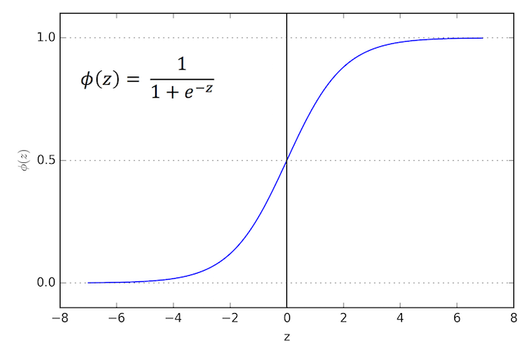
Sigmoid Function
The Sigmoid (aka Logistic) Function takes in any value and outputs it to be between 0 and 1.
Math &
Statistics
Machine Learning
DS
Software
Research
Domain
Knowledge

Slide 51
Sigmoid Function
This means we can take our Linear Regression Solution and place it into the Sigmoid Function.
Math &
Statistics
Machine Learning
DS
Software
Research
Domain
Knowledge

Slide 52
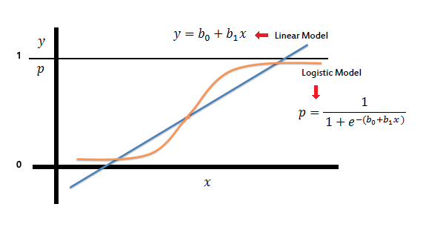
Sigmoid Function
This means we can take our Linear Regression Solution and place it into the Sigmoid Function.
Math &
Statistics
Machine Learning
DS
Software
Research
Domain
Knowledge

Slide 53
Sigmoid Function
This results in a probability from 0 to 1 of belonging in the 1 class.
Math &
Statistics
Machine Learning
DS
Software
Research
Domain
Knowledge

Slide 54
Sigmoid Function
We can set a cutoff point at 0.5, anything below it results in class 0, anything above is class 1.
Math &
Statistics
Machine Learning
DS
Software
Research
Domain
Knowledge

Slide 55
Review
We use the logistic function to output a value ranging from 0 to 1. Based off of this probability we assign a class.
Math &
Statistics
Machine Learning
DS
Software
Research
Domain
Knowledge

Slide 56
Model Evaluation
After you train a logistic regression model on some training data, you will evaluate your model’s performance on some test data.
You can use a confusion matrix to evaluate classification models.
Math &
Statistics
Machine Learning
DS
Software
Research
Domain
Knowledge

Slide 57
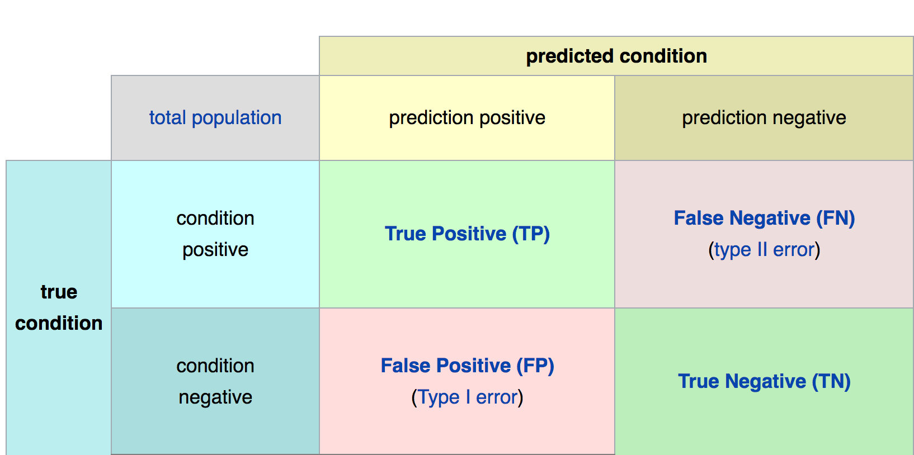
Confusion Matrix
Math &
Statistics
Machine Learning
DS
Software
Research
Domain
Knowledge

Slide 58
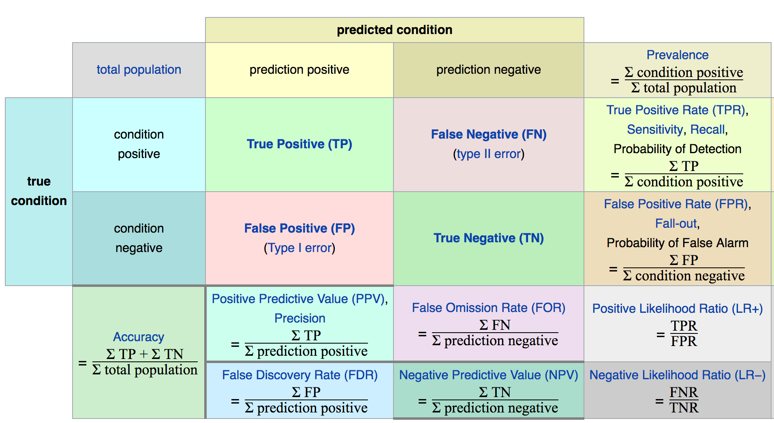
Confusion Matrix
Math &
Statistics
Machine Learning
DS
Software
Research
Domain
Knowledge

Slide 59
Model Evaluation
The main point to remember with the confusion matrix and the various calculated metrics is that they are all fundamentally ways of comparing the predicted values versus the true values.
What constitutes “good” metrics, will really depend on the specific situation!
Math &
Statistics
Machine Learning
DS
Software
Research
Domain
Knowledge

Slide 60
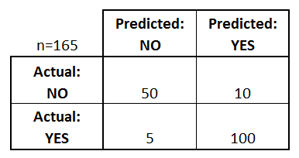
Model Evaluation
We can use a confusion matrix to evaluate our model.
For example, imagine testing for disease.
Math &
Statistics
Machine Learning
Example: Test for presence of disease
NO = negative test = False = 0
YES = positive test = True = 1
DS
Software
Research
Domain
Knowledge

Slide 61
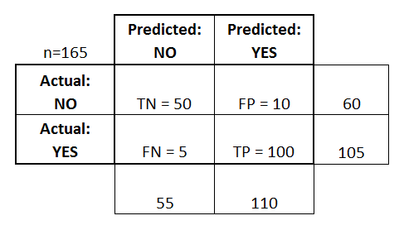
Confusion Matrix
Basic Terminology:
True Positives (TP)
True Negatives (TN)
False Positives (FP)
False Negatives (FN)
Math &
Statistics
Machine Learning
DS
Software
Research
Domain
Knowledge

Slide 62
Confusion Matrix
Math &
Statistics
Machine Learning
Accuracy:
Overall, how often is it correct?
(TP + TN) / total = 150/165 = 0.91
DS
Software
Research
Domain
Knowledge

Slide 63
Confusion Matrix
Misclassification Rate (Error Rate):
Overall, how often is it wrong?
(FP + FN) / total = 15/165 = 0.09
Math &
Statistics
Machine Learning
DS
Software
Research
Domain
Knowledge

Slide 64
Model Evaluation
Binary classification has some of its own special classification metrics.
These include visualizations of metrics from the confusion matrix.
The Receiver Operator Curve (ROC) curve was developed during World War II to help analyze radar data.
Math &
Statistics
Machine Learning
DS
Software
Research
Domain
Knowledge

Slide 65
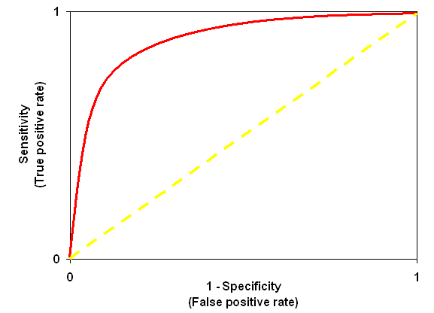
Model Evaluation
The ROC curve:
Math &
Statistics
Machine Learning
DS
Software
Research
Domain
Knowledge

Slide 66
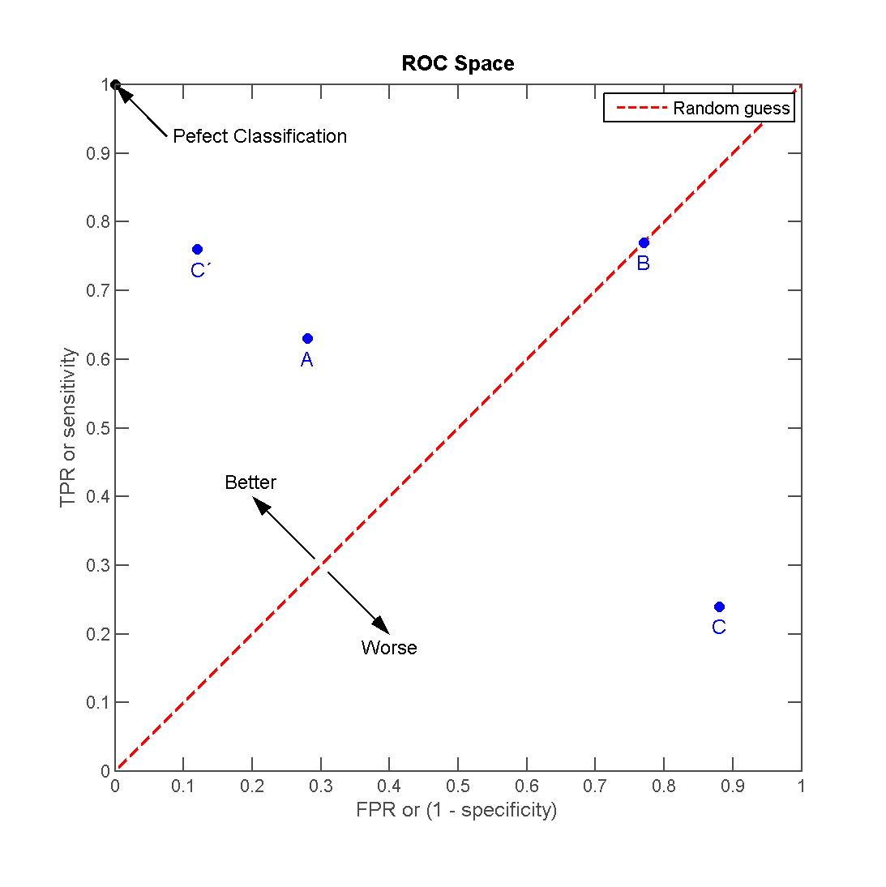
Model Evaluation
Math &
Statistics
Machine Learning
DS
Software
Research
Domain
Knowledge

Slide 67

Predicting House Prices
We'll use the California Housing Dataset, which contains various features like crime rate, average number of rooms per dwelling, and more to predict house prices.

Slide 68
Import Libraries &Load and Explore the Dataset
# Import necessary libraries
import numpy as np
import pandas as pd
import matplotlib.pyplot as plt
from sklearn.model_selection import train_test_split
from sklearn.linear_model import LinearRegression
from sklearn.metrics import mean_squared_error, r2_score
from sklearn.datasets import fetch_california_housing
# Load the California Housing dataset
housing = fetch_california_housing()
# Convert to pandas DataFrame for easier manipulation
data = pd.DataFrame(housing.data, columns=housing.feature_names)
data['PRICE'] = housing.target
# Display the first 5 rows of the dataset
print("First 5 rows of the dataset:")
print(data.head())
# Select features and target
X = data[['MedInc']] # Independent variable (Median Income)
y = data['PRICE'] # Dependent variable (House price)
Features Explanation:
CRIM: Crime rate per capita.
RM: Average number of rooms per dwelling.
LSTAT: Percentage of lower status population.
PRICE: Median value of homes in $1000s.

Slide 69
Import Libraries &Load and Explore the Dataset
# Split the data into training and testing sets (80% training, 20% testing)
X_train, X_test, y_train, y_test = train_test_split(X, y, test_size=0.2, random_state=42)
# Initialize and train the Linear Regression model
model = LinearRegression()
model.fit(X_train, y_train)
# Predict house prices for the test set
y_pred = model.predict(X_test)
# Evaluate the model
mse = mean_squared_error(y_test, y_pred)
r2 = r2_score(y_test, y_pred)
print(f'\nMean Squared Error: {mse:.2f}')
print(f'R-squared: {r2:.2f}')
First 5 rows of the dataset:
MedInc HouseAge AveRooms ... Latitude Longitude PRICE
0 8.3252 41.0 6.984127 ... 37.88 -122.23 4.526
1 8.3014 21.0 6.238137 ... 37.86 -122.22 3.585
2 7.2574 52.0 8.288136 ... 37.85 -122.24 3.521
3 5.6431 52.0 5.817352 ... 37.85 -122.25 3.413
4 3.8462 52.0 6.281853 ... 37.85 -122.25 3.422
[5 rows x 9 columns]
Mean Squared Error: 0.71
R-squared: 0.46

Slide 70
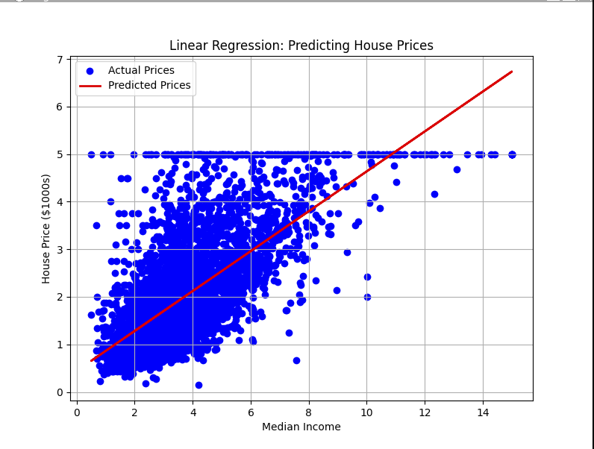
Import Libraries &Load and Explore the Dataset
# Visualize the results
plt.figure(figsize=(8, 6))
plt.scatter(X_test, y_test, color='blue', label='Actual Prices')
plt.plot(X_test, y_pred, color='red', linewidth=2, label='Predicted Prices')
plt.xlabel('Median Income')
plt.ylabel('House Price ($1000s)')
plt.title('Linear Regression: Predicting House Prices')
plt.legend()
plt.grid(True)
plt.show()

Slide 71
Explanation
Mean Squared Error (MSE)
measures the average of the squares of the errors between predicted and actual values. Lower values indicate better fit.
R-squared
measures how well the independent variable(s) explain the variance in the dependent variable.
It ranges from 0 to 1, where 1 indicates a perfect fit. In this example, R-squared = 0.48 means the model explains 48% of the variance in house prices.

Slide 72
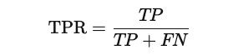
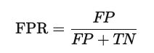
ROC Curves (Receiver Operating Characteristic Curves)
ROC curves
used to evaluate the performance of binary classification models by plotting the True Positive Rate (TPR) against the False Positive Rate (FPR) at various threshold settings.
True Positive Rate (TPR):
Also known as sensitivity or recall, it’s the ratio of correctly predicted positive observations to all actual positives.
False Positive Rate (FPR):
The ratio of incorrectly predicted positive observations to all actual negatives.
AUC (Area Under the Curve):
Measures the overall performance of the model. An AUC of 1 indicates a perfect model, while an AUC of 0.5 represents random guessing.
Use Case: ROC curves are commonly used when there is a class imbalance. A higher AUC means the model is better at distinguishing between positive and negative classes.

Slide 73
Breast Cancer Wisconsin dataset
import numpy as np
import matplotlib.pyplot as plt
from sklearn.datasets import load_breast_cancer
from sklearn.model_selection import train_test_split
from sklearn.preprocessing import StandardScaler
from sklearn.linear_model import LogisticRegression
from sklearn.metrics import roc_curve, roc_auc_score
# Load the Breast Cancer dataset
data = load_breast_cancer()
X = data.data
y = data.target
print(f"Feature names: {data.feature_names}")
print(f"Number of samples: {X.shape[0]}")
print(f"Number of features: {X.shape[1]}")
# Split the data into training and testing sets (70% train, 30% test)
X_train, X_test, y_train, y_test = train_test_split(
X, y, test_size=0.3, random_state=42, stratify=y
)
# Standardize the features
scaler = StandardScaler()
X_train = scaler.fit_transform(X_train)
X_test = scaler.transform(X_test)
# Initialize and train the Logistic Regression model
model = LogisticRegression(solver='liblinear', random_state=42)
model.fit(X_train, y_train)
Feature names: ['mean radius' 'mean texture' 'mean perimeter' ... 'worst fractal dimension']
Number of samples: 569
Number of features: 30

Slide 74
Breast Cancer Wisconsin dataset
# Predict probabilities for the test set
y_scores = model.predict_proba(X_test)[:, 1] # Probability of the positive class
# Compute ROC curve metrics
fpr, tpr, thresholds = roc_curve(y_test, y_scores)
# Compute AUC (Area Under the Curve)
auc_score = roc_auc_score(y_test, y_scores)
print(f"AUC Score: {auc_score:.2f}")
AUC Score: 0.99

Slide 75
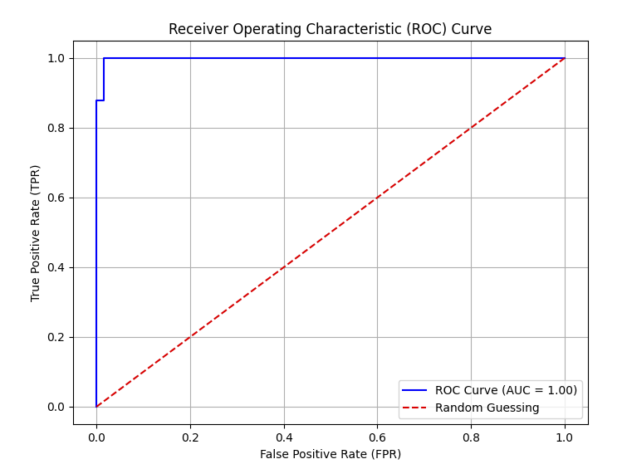
Plot the ROC Curve
plt.figure(figsize=(8, 6))
plt.plot(fpr, tpr, color='blue', label=f'ROC Curve (AUC = {auc_score:.2f})')
plt.plot([0, 1], [0, 1], color='red', linestyle='--', label='Random Guessing')
plt.xlabel('False Positive Rate (FPR)')
plt.ylabel('True Positive Rate (TPR)')
plt.title('Receiver Operating Characteristic (ROC) Curve')
plt.legend(loc='lower right')
plt.grid(True)
plt.show()

Slide 76
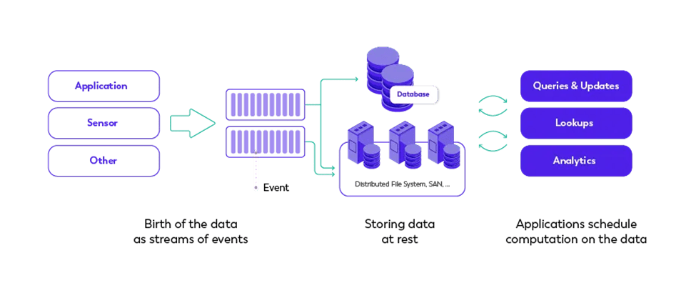
STREAM PROCESSING

Slide 77
Real-time stream processing
the continuous processing of data as it is generated, enabling immediate analysis and decision-making.
Instead of waiting for data to accumulate and then processing it in batches (as with traditional batch processing),
stream processing handles events as they arrive, providing insights, responses, or transformations instantly or within milliseconds to seconds.

Slide 78
Key Characteristics
Continuous Data Flow:
Data is processed as soon as it arrives, typically in an unbounded and continuous stream.
It’s ideal for environments where data is generated constantly, such as sensor networks, financial markets, or social media feeds.
Low Latency:
there is minimal delay between data ingestion and the processing of that data.
This allows for immediate insights and actions.
Event-Driven:
Data in real-time stream processing is typically in the form of discrete events, such as user clicks, financial transactions, or sensor readings.
Systems respond to these events almost instantly, triggering actions or updating states.
Stateful Processing:
Stream processors often maintain a state across different events.
counting occurrences of events, tracking patterns over time, or joining streams of data.
A system like Apache Flink is highly optimized for managing state efficiently in real-time applications.
Windowing:
In stream processing, data is often aggregated over windows of time (e.g., every 5 minutes) or a certain number of events (e.g., after every 100 events).
This allows for meaningful analysis and summarization of the continuous data flow.

Slide 79
Use Cases of Real-Time Stream Processing
Fraud Detection:
real-time stream processing can detect suspicious transactions instantly and flag or block them before harm is done.
Real-Time Analytics:
For online platforms, clickstream analysis in real-time helps provide instant insights into user behavior, enabling dynamic content adjustments or recommendations.
Internet of Things (IoT):
Devices and sensors continuously generate data. Real-time processing allows for immediate actions, such as shutting down a machine in case of overheating, or predictive maintenance based on continuous monitoring of equipment.
Financial Market Analysis:
Stream processing is critical in stock exchanges, where real-time data processing is necessary to monitor market movements and execute trades based on live data.
Real-Time Recommendations:
Services like Netflix and Spotify use real-time stream processing to analyze user interactions and provide personalized recommendations immediately.

Slide 80
Technologies Used for Real-Time Stream Processing
Apache Flink:
Optimized for real-time, stateful stream processing with low-latency and fault tolerance features.
Apache Kafka:
Often used as a distributed message broker, handling data streaming between producers and consumers.
Apache Storm:
Another real-time stream processing framework, designed for distributed and fault-tolerant processing.
Apache Spark Structured Streaming:
A micro-batch processing framework for near real-time analytics, which offers a simpler approach to streaming.

Slide 81
Telecom Churn Prediction
Scenario:
A telecom company wants to predict customer churn in real-time to reduce attrition.
They implement a real-time churn prediction system based on customer usage patterns and interactions with support.
Data Source:
Stream customer call logs, data usage, service complaints, and billing information through Kafka.
Flink for Stream Processing:
Use Flink to preprocess the data, calculate real-time metrics (e.g., call duration, internet usage over the past 24 hours), and detect patterns (e.g., customers frequently contacting support).
Real-time features such as "days since last payment" or "increase in service complaints" are computed.
Churn Prediction Model:
A pre-trained logistic regression model is integrated into the Flink pipeline to predict the probability of churn.
Real-Time Action:
If the churn probability is high, the system triggers an SMS offering a discount or enhanced service. If the customer is still dissatisfied, it escalates to a human support team for intervention.

Slide 82
Churn Prediction
Churn prediction is the process of identifying customers who are likely to stop using a service or product.
In real-time, this involves processing and analyzing customer data as it is generated, allowing companies to intervene promptly and reduce customer attrition.
Real-time churn prediction enables businesses, such as telecom companies, online platforms, and subscription services, to take immediate action, such as offering incentives or sending notifications to at-risk customers.

Slide 83
Telecom company wants to predict customer churn
The telecom company wants to prevent churn by analyzing real-time customer data, such as:
Call durations.
Data usage.
Interaction with customer support.
Billing and payment history.
Network issues or service complaints.
The goal is to use this data to predict which customers are likely to stop using the service soon and intervene with offers, discounts, or personalized communication before they leave.

Slide 84

Step-by-Step Real-Time Churn Prediction Process

Slide 85
Data Collection (Real-Time Ingestion)
Data Sources: The telecom company continuously collects real-time data from multiple sources:
Call logs (e.g., dropped calls, call durations).
Data usage patterns (e.g., internet usage, session time).
Support interactions (e.g., complaints, service requests).
Billing information (e.g., late payments, subscription renewals).
Tool: Apache Kafka is used to stream this real-time data into the processing pipeline.
Example: A customer calls telecom support several times in a short period due to network issues, raising the probability of churn.

Slide 86
Preprocessing and Feature Engineering
Data from Kafka is consumed by Apache Flink for real-time processing.
Flink cleans and transforms the data and generates relevant features, such as:
Time since last call.
Number of dropped calls in the last week.
Total data consumption in the last month.
Frequency of customer support interactions.
Payment delays or missed payments.
Example: A feature like "increased support calls in the last 7 days" or "dropped calls in the last 24 hours" is calculated for every customer.

Slide 87
Churn Prediction Model (Real-Time Scoring)
Machine Learning Model:
A pre-trained machine learning model (e.g., logistic regression, random forest, or deep learning) is used to predict the churn probability.
This model is trained on historical data of customer behavior, past churn events, and retention outcomes.
Real-Time Model Scoring:
As data is processed in real-time, the features generated by Flink are passed to the model to predict whether a customer is likely to churn.
Tools: The model can be deployed using Flink ML or served using TensorFlow Serving for real-time predictions.
Example:
The system computes a churn probability of 85% for a customer who has reported multiple network issues, decreased their data usage, and had delayed payments in the last month.

Slide 88
Real-Time Actions and Interventions
Intervention Strategy: If the churn probability exceeds a threshold (e.g., 80%), the system triggers an action in real-time:
Sending personalized offers (e.g., discounts, data packages).
Escalating to customer service for a follow-up call.
Sending retention emails or SMS messages.
Tools: Integration with CRM systems, email/SMS services, or automated chatbots for direct communication.
Example: If the model predicts that a customer is at high risk of churning, the system might immediately send an SMS offering a 10% discount on the next month's bill or provide additional data usage for free.

Slide 89
Continuous Monitoring and Feedback Loop
Monitoring Customer Behavior:
After the intervention, customer behavior is monitored in real-time to determine whether the churn prediction was accurate or if the intervention was effective.
If the customer continues to use the service or accepts the offer, this positive outcome is tracked.
If the customer still shows signs of churn, further actions may be taken, such as direct outreach by the customer support team.
Feedback and Model Retraining:
The outcomes of interventions (e.g., customer retention or churn) are fed back into the machine learning pipeline to improve the model.
Periodically, the model is retrained using updated data to reflect the latest customer behavior trends.
Example:
If the customer accepts the discount offer and continues using the service, the system tracks this behavior and adjusts the churn model to recognize the effectiveness of the discount in preventing churn.

Slide 90
Real-Time Churn Prediction Pipeline (Using Apache Kafka and Apache Flink)
Data Stream Ingestion:
Kafka streams customer activity data in real-time to the processing pipeline.
Data Preprocessing and Feature Engineering:
Apache Flink consumes the Kafka stream, applies transformations, cleans data, and computes real-time features (e.g., "time since last purchase").
Model Scoring:
The real-time features are passed to a pre-trained model (deployed using TensorFlow Serving or Flink ML), which predicts the churn probability.
Real-Time Intervention:
If the churn probability exceeds a certain threshold (e.g., 80%), the system triggers immediate actions, such as sending offers through a CRM system or escalating customer support interactions.
Continuous Monitoring and Feedback:
The pipeline is monitored continuously, and feedback (e.g., whether the customer accepted the offer or stayed) is used to retrain the model periodically.

Slide 91
Customer Lifetime Value (CLV) Estimation
Customer Lifetime Value (CLV) is a metric that estimates the total revenue a business can reasonably expect from a customer throughout their relationship.
It helps companies understand the long-term value of their customers, guiding decisions on marketing, sales, and customer retention strategies.
Accurate CLV estimation allows businesses to optimize customer acquisition costs and focus on retaining the most valuable customers.

Slide 92
Components of CLV
Average Purchase Value (APV):
The average amount a customer spends on a purchase.
Purchase Frequency (PF):
The number of purchases a customer makes over a specific period.
Customer Lifespan (CL):
The length of time a customer continues to make purchases from the business.
Gross Margin (GM):
The percentage of revenue retained after deducting the cost of goods sold (COGS).

Slide 93
CLV Formula
CLV can be estimated using the formula:
CLV=APV×PF×CL×GM
However, real-time CLV estimation considers dynamic customer behavior, and data is constantly updated as new customer interactions occur.

Slide 94
E-Commerce CLV Estimation
Scenario:
A large e-commerce company wants to estimate the real-time CLV of its customers to personalize marketing strategies and optimize spending on customer acquisition.
Data Sources:
The company collects real-time data from its website, including transaction history, browsing behavior, and customer interactions with promotional emails.
Data Processing:
Using Apache Kafka and Flink, the company streams customer transaction data and calculates real-time metrics like purchase frequency and average order value.

Slide 95
E-Commerce CLV Estimation
CLV Model:
A pre-trained regression model is deployed using TensorFlow Serving. The model estimates CLV based on customer purchase history, browsing patterns, and responses to promotions.
Personalized Marketing:
Customers with high CLV are offered loyalty rewards or special discounts, while those with lower CLV receive personalized re-engagement offers via email or SMS.
Real-Time Adjustment:
The CLV model continuously updates based on new customer data, allowing the company to adjust its marketing strategies dynamically.

Slide 96
Benefits of Real-Time CLV Estimation
Personalized Marketing: Businesses can tailor marketing campaigns to individual customers, maximizing revenue potential.
Improved Resource Allocation: By understanding which customers are most valuable, companies can focus resources on retention and growth for those segments.
Optimized Acquisition: Companies can adjust customer acquisition strategies, focusing on acquiring high-CLV customers.
Increased Retention: Personalized offers based on CLV predictions help retain valuable customers and reduce churn.
Business Growth: CLV estimation improves decision-making, enhancing profitability and long-term business growth.

Slide 97
Apache Flink

Slide 98
What is Apache Flink?
open-source, distributed engine for stateful processing over unbounded (streams) and bounded (batches) data sets.
Stream processing applications are designed to run continuously, with minimal downtime, and process data as it is ingested.
Apache Flink is designed for low latency processing, performing computations in-memory, for high availability, removing single point of failures, and to scale horizontally.
Apache Flink’s features include advanced state management with exactly-once consistency guarantees, event-time processing semantics with sophisticated out-of-order and late data handling.
Apache Flink has been developed for streaming-first, and offers a unified programming interface for both stream and batch processing.

Slide 99
Use of Apache Fink
Event-driven applications
ingesting events from one or more event streams and executing computations, state updates or external actions.
Stateful processing allows implementing logic beyond the Single Message Transformation, where the results depend on the history of ingested events.
Data Analytics applications
extracting information and insights from data.
Traditionally executed by querying finite data sets, and re-running the queries or amending the results to incorporate new data.
With Apache Flink, the analysis can be executed by continuously updating, streaming queries or processing ingested events in real-time, continuously emitting and updating the results.
Data pipelines applications
transforming and enriching data to be moved from one data storage to another.
Traditionally, extract-transform-load (ETL) is executed periodically, in batches.
With Apache Flink, the process can operate continuously, moving the data with low latency to their destination.

Slide 100
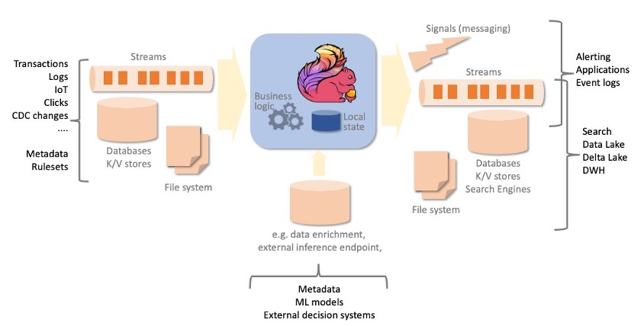

Slide 101
How does Apache Flink work?
Flink is a high throughput, low latency stream processing engine.
A Flink application consists of an arbitrary complex acyclic dataflow graph, composed of streams and transformations.
Data is ingested from one or more data sources and sent to one or more destinations.
Source and destination systems can be streams, message queues, or datastores, and include files, popular database and search engines.
Transformations can be stateful, like aggregations over time windows or complex pattern detection.
Fault tolerance is achieved by two separate mechanisms:
automatic and periodic checkpointing of the application state, copied to a persistent storage,
to allow automatic recovery in case of failure;
on-demand savepoints, saving a consistent image of the execution state, to allow stop-and-resume, update or fork your Flink job, retaining the application state across stops and restarts.
Checkpoint and savepoint mechanisms are asynchronous, taking a consistent snapshot of the state without “stopping the world”, while the application keeps processing events.

Slide 102
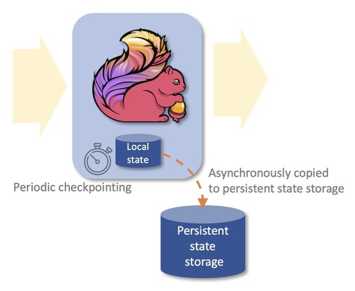

Slide 103
What are the benefits of Apache Flink?
Process both unbounded (streams) and bounded (batches) data sets
Apache Flink can process both unbounded and bounded data sets, i.e., streams and batch data.
Unbounded streams have a start but are virtually infinite and never end.
Processing can theoretically never stop.
Bounded data, like tables, are finite and can be processed from the beginning to the end in a finite time.
Apache Flink provides algorithms and data structures to support both bounded and unbounded processing through the same programming interface.
Applications processing bounded data will end their execution when reaching the end of the input data sets.
Run applications at scale
Apache Flink is designed to run stateful applications at virtually any scale. Processing is parallelized to thousands of tasks, distributed multiple machines, concurrently.
State is also partitioned and distributed horizontally, allowing to maintain several terabytes across multiple machines.
State is checkpointed to a persistent storage incrementally.

Slide 104
What are the benefits of Apache Flink?
In-memory performance
Data flowing through the application and state are partitioned across multiple machines.
Hence, computation can be completed by accessing local data, often in-memory.
Exactly-once state consistency
Applications beyond single message transformations are stateful.
The business logic needs to remember events or intermediate results.
Apache Flink guarantees consistency of the internal state, even in case of failure and across application stop and restart.
The effect of each message on the internal state is always applied exactly-once, regardless the application may receive duplicates from the data source on recovery or on restart.
Wide range of connectors
Apache Flink has a number of proven connectors to popular messaging and streaming systems, data stores, search engines, and file system.
Some examples are Apache Kafka, Amazon Kinesis Data Streams, Amazon SQS, Active MQ, Rabbit MQ, NiFi, OpenSearch and ElasticSearch, DynamoDB, HBase, and any database providing JDBC client.

Slide 105


Slide 106
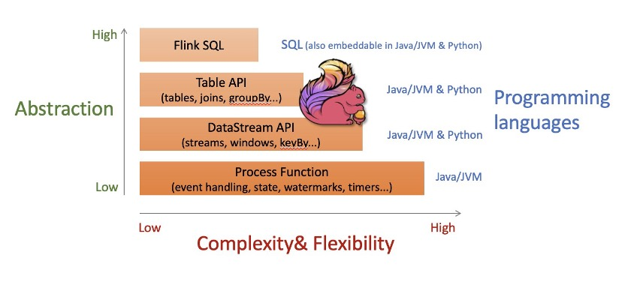
Multiple levels of abstractions
Apache Flink offers multiple level of abstraction for the programming interface.
From higher level streaming SQL and Table API, using familiar abstractions like table, joins and group by.
The DataStream API offers a lower level of abstraction but also more control, with the semantics of streams, windowing and mapping.
And finally, the ProcessFunction API offers fine control on the processing of each message and direct control of the state.
All programming interfaces work seamlessly with both unbounded (streams) and bounded (tables) date sets.
Different levels of abstractions can be used in the same application, as the right tool to solve each problem.

Slide 107







